Slide 1
Exercise Performance Analysis using Data Mining Techniques
B565 Data Mining
Kiran Karandikar
Satyajeet Sarfare

Slide 2
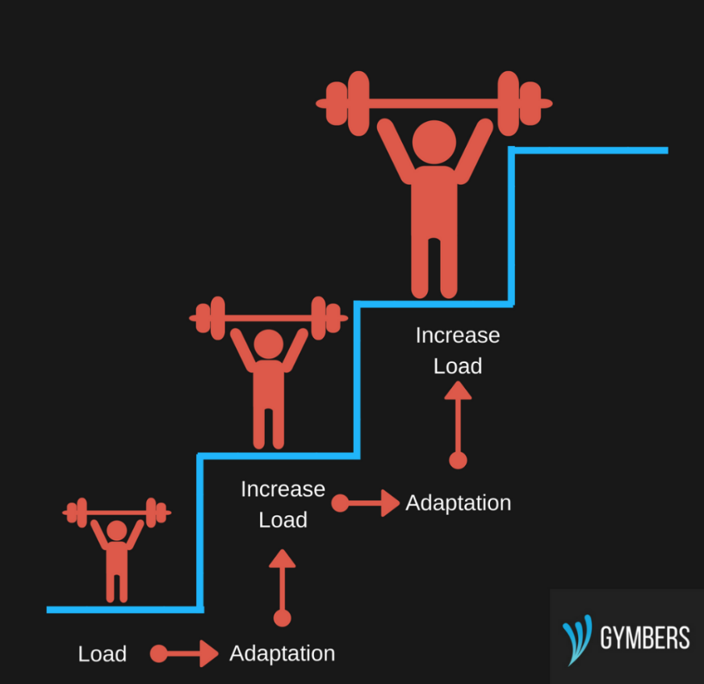
Project Description
We intend to use historical work out data to gain insights about how to efficiently one can plan his future workout sessions. Here the key concept is Progressive Overload.
Progeressive overload is one of the key factor when it come to reaching one’s strength or hypertrophy goals.
Progressive overload takes multiple forms (sets, reps, time under tension, rest periods) but workout volume or exercise volume is one of the major component.
Prediction will be done on feature Volume - a continuous feature. Volume is given by the formula:
Sets x Reps x Weight
Able to predict, one’s progression in terms of workout volume helps in fine tuning the exercise selection and programming.
By examining one’s historical workout log, we can predict future performances or drop in performance.

Slide 3
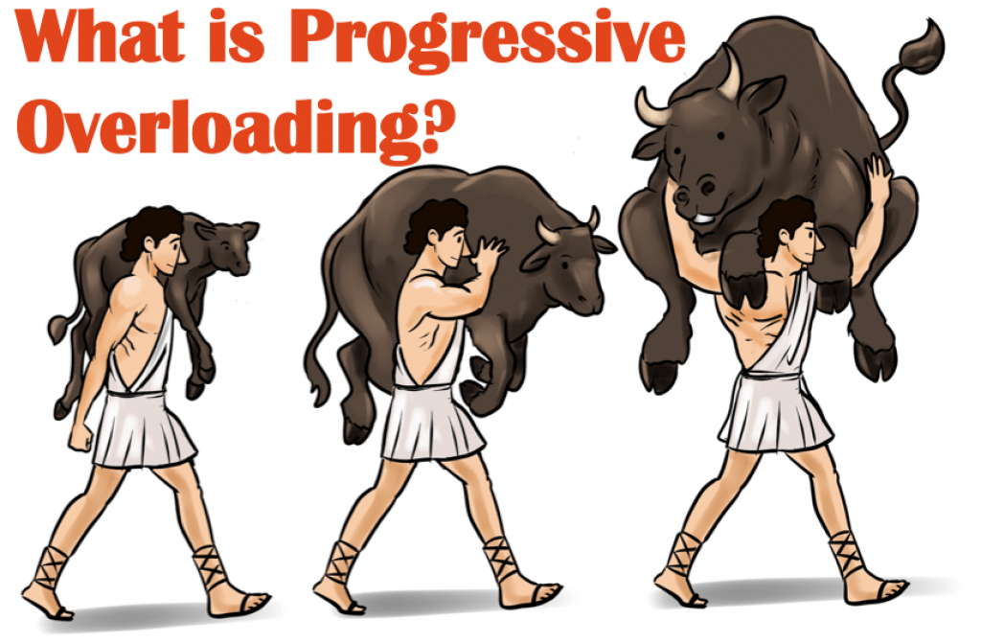
Key Terminologies And Concepts
Exercise, Sets, Reps, Volume
Progressive Overload.
Hypertrophy & strength
SAID Principle (Specific Adaptation to Imposed Demands)
Training Curve

Slide 4
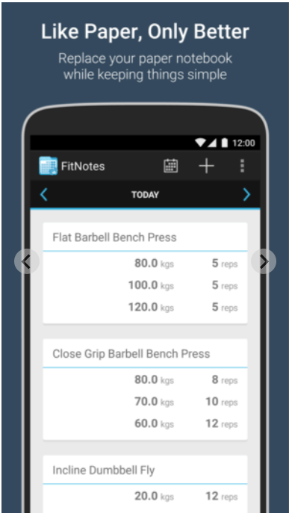
Dataset :
Dataset vendor - Personal exercise log which was tracked using using Android App Fitnotes
Historical exercise log from 2019-2022.
Time series based data with continuous target variable(Volume) with similar characteristics like stock market data.
Downside: Small size dataset.

Slide 5
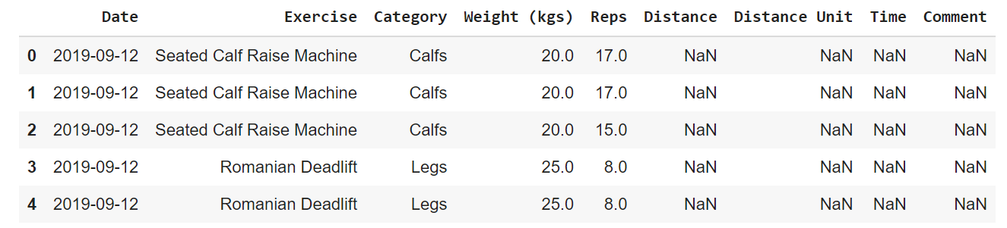
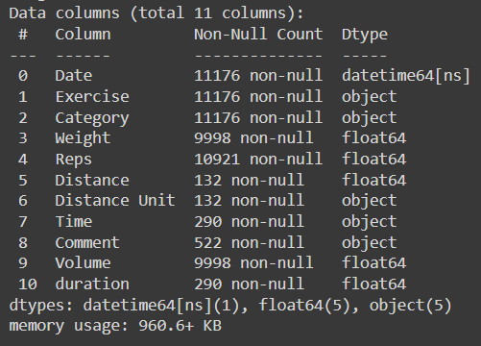
Features : Date, Category, Exercise Name, Weight, Reps, Time, Distance, Distance units.

Slide 6
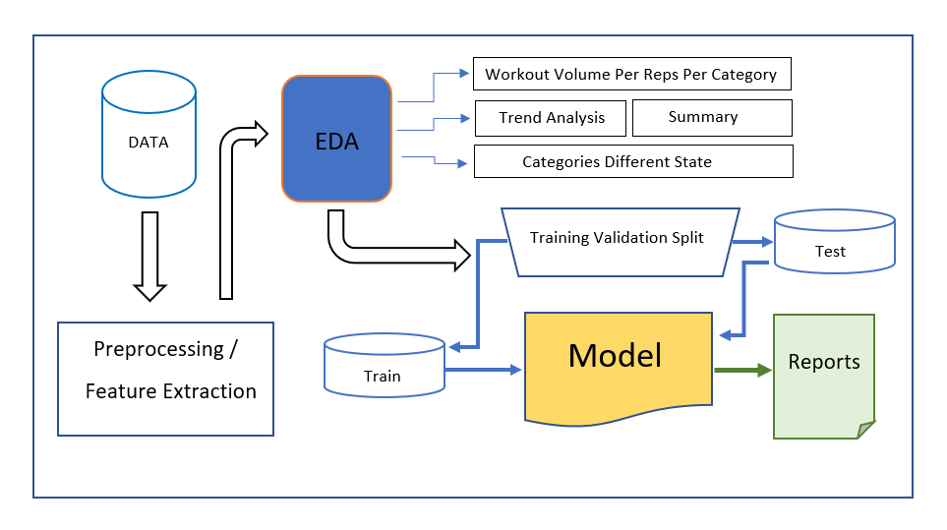
Project Workflow:

Slide 7
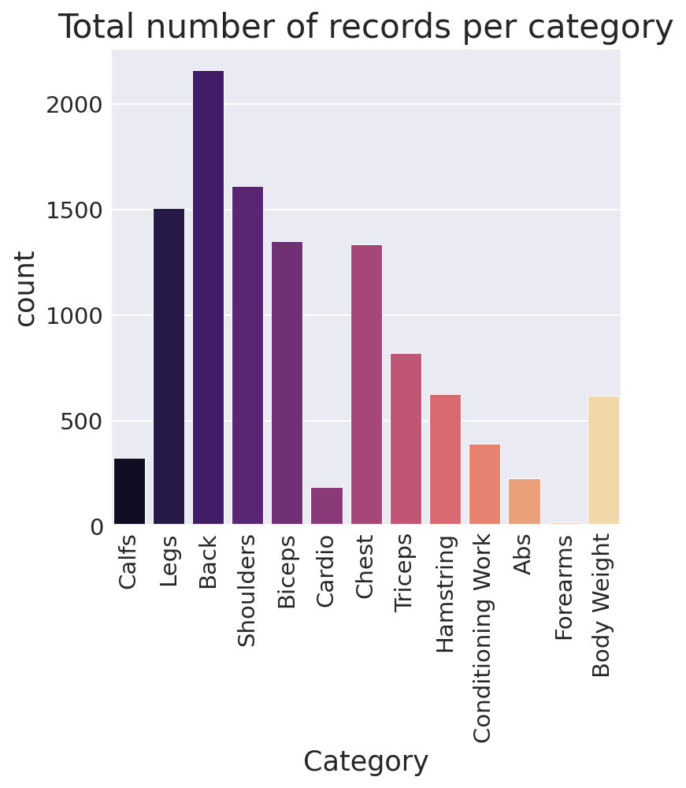
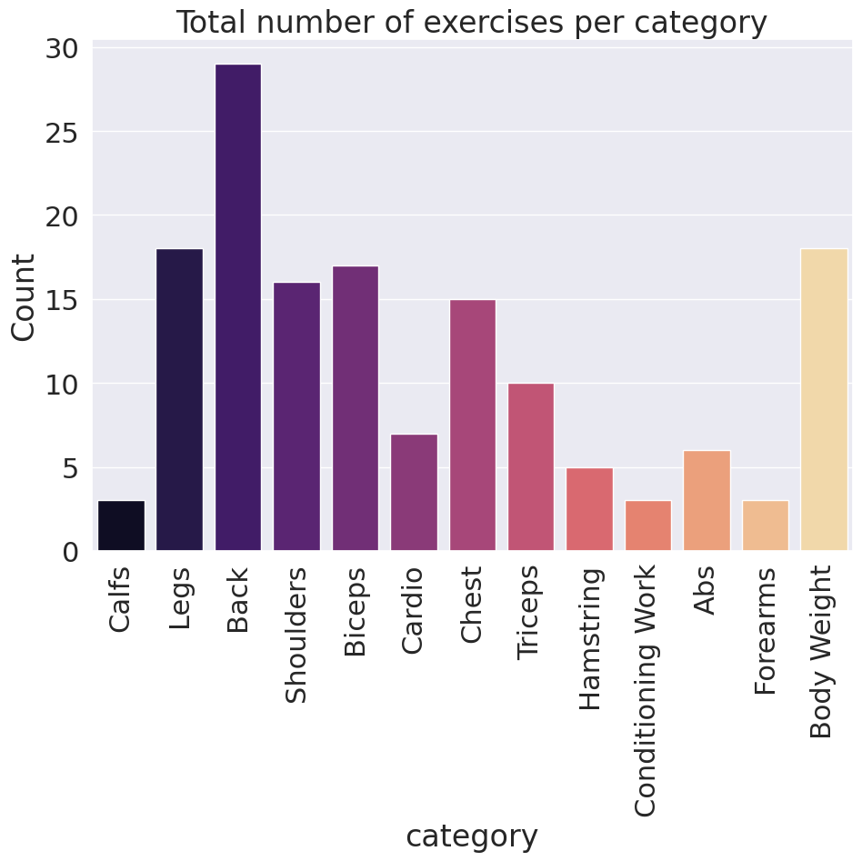
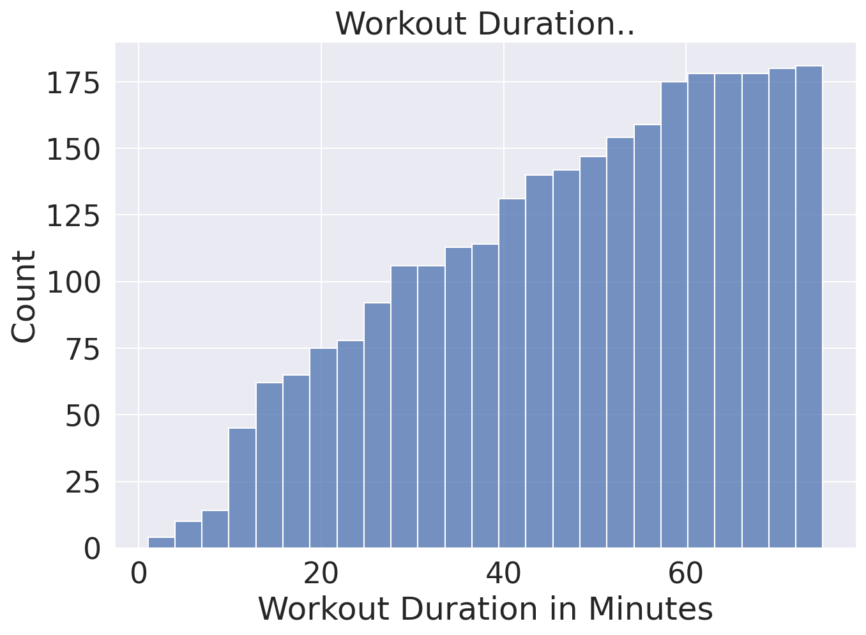
EDA and Feature Engineering
Converting missing/NaN values to desired values
The different categories and Exercise Name are shown below.

Slide 8
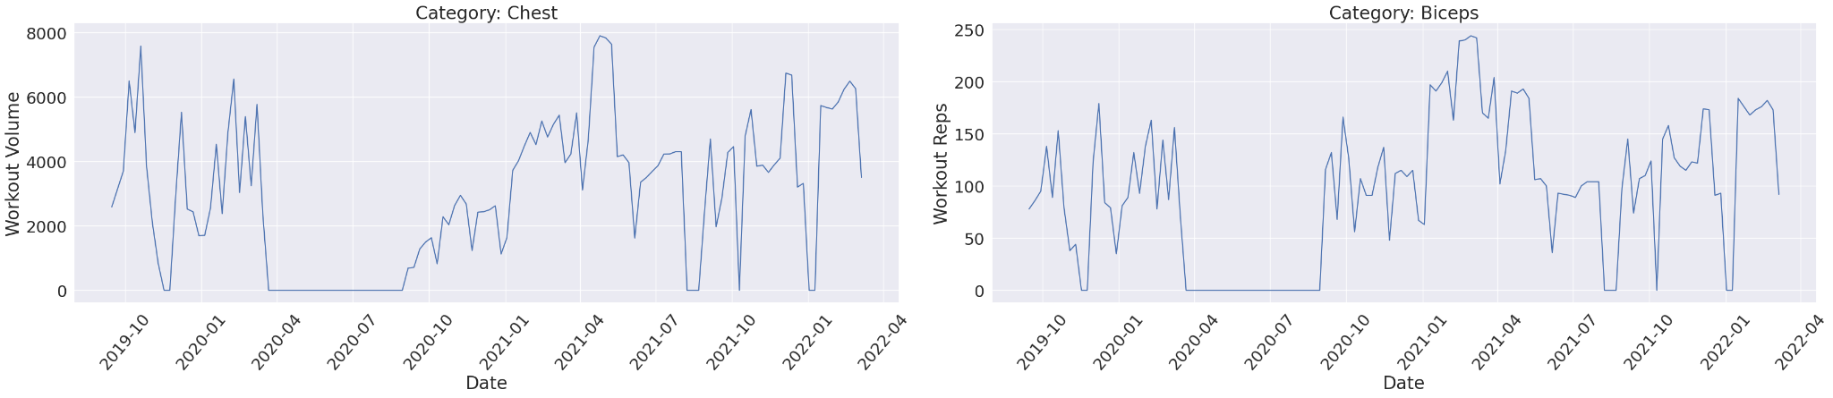
EDA and Feature Engineering
These graphs help us recognize the different states of workout throughout

Slide 9
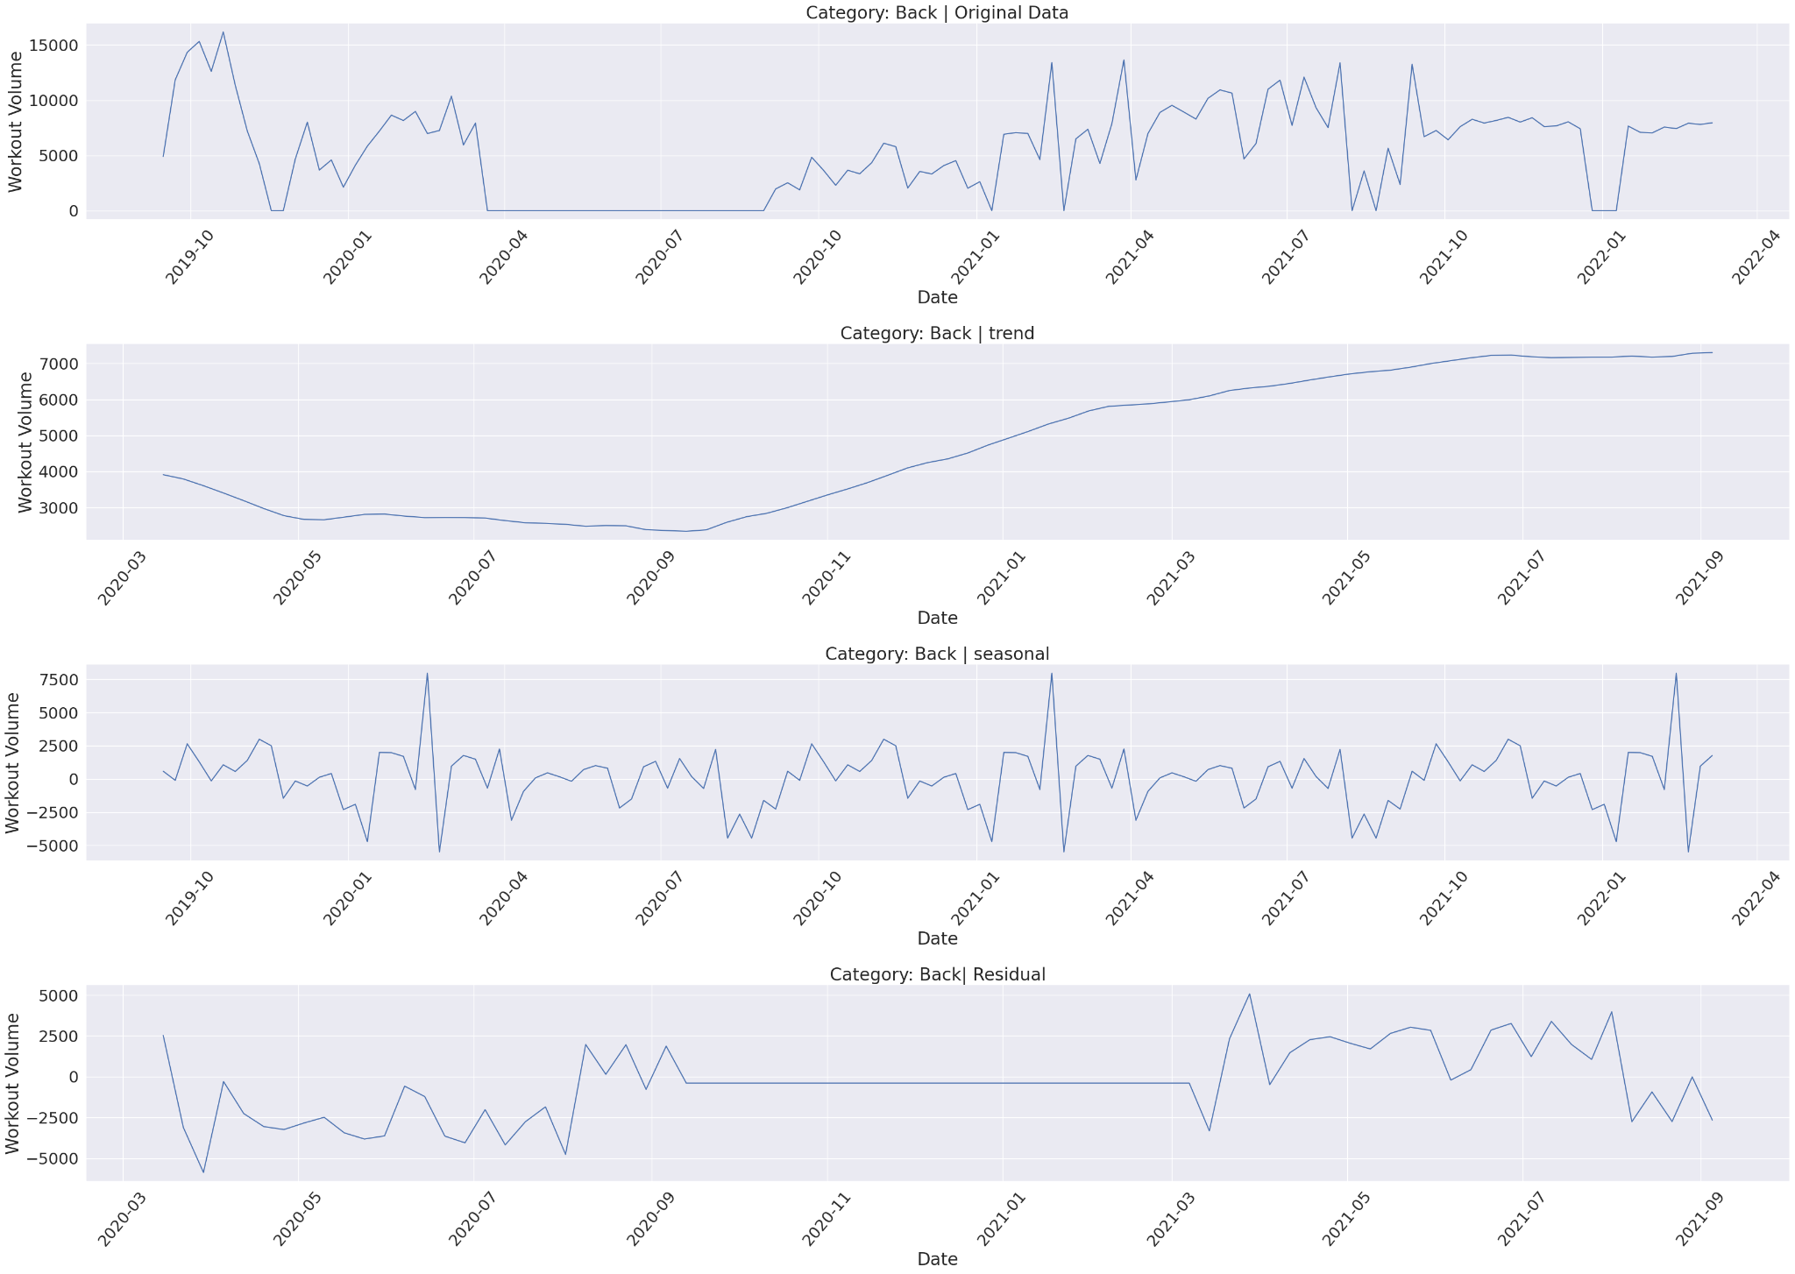
EDA and Feature Engineering
To perform trend analysis, we are using the library statsmodels tsa.seasonal.seasonal_decompose

Slide 10
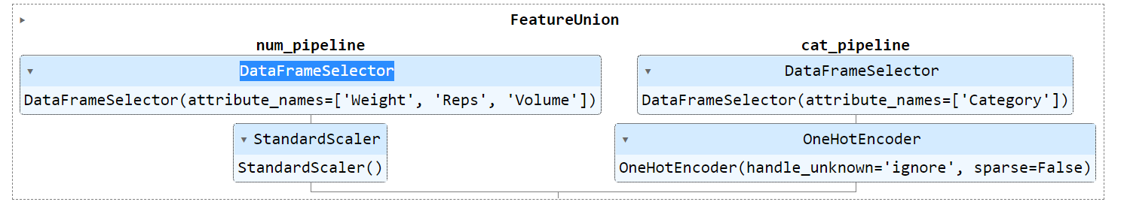
Action Plan
The figure below shows the pipeline being used for Data Prep which will be used in end-to-end ML pipeline.
Since the problem statement involves time series data and prediction of continuous variable, we will be using following regression models.
LinearRegression ; Ridge and lasso ; SGDRegressor ; ElasticNet.
Hyperparameter tuning using gridsearchCV will be used and cross validation scores will be calculated using “model_selection.TimeSeriesSplit”
These are the following loss functions used to track accuracy :- mean absolute error, mean squared error, mean absolute percentage error.

Slide 11
Future Scope
Building the collection of data from multiple users/trainees.
Building the ensemble of models for recommending to for every lifter.
Data can be aggregated by time on which time series analysis can be performed.
Provide guidance on rest phases and heightened workout phases to maximize the growth.
Include multitude features.
Can use similar concepts in other individual sports like swimming/bike riding to determine the performance metrics.

Slide 12
References
Maximizing Muscle Hypertrophy: A Systematic Review of Advanced Resistance Training Techniques and Methods - Michal Krzysztofik, Michal Wilk , Grzegorz Wojdała and Artur Goła´.
Precision strength training: Data-driven artificial intelligence approach to strength and conditioning - Petteri Teikari, Aleksandra Pietrusz
A mathematical model-based approach to optimize loading schemes of isometric resistance training sessions Johannes L. Herolda and Andreas Sommera
Artificial Intelligence of Things in Sports Science: Weight Training as an Example - William Cheng-Chung Chu, Chihhsiong Shih, Wen-Yi Chou, Sheikh Iqbal Ahamed,Pao-Ann Hsiung.
Variability in exercise physiology: Can capturing intra-individual variation help better understand true inter-individual responses? - Oliver J. Chrzanowski-Smith, Eva Piatrikova, James A. Betts, Sean Williams & Javier T. Gonzalez
Overreaching and overtraining in strength sports and resistance training: A scoping review Lee Bell , Alan Ruddock , Thomas Maden-Wilkinson & David. Rogerson

Slide 13
References
Predicting Physical Exercise Adherence in Fitness Apps Using a Deep Learning Approach Oscar Jossa-Bastidas, Sofia Zahia, Andrea Fuente-Vidal, Néstor Sánchez Férez, Oriol Roda Noguera, Joel Montane,Begonya Garcia-Zapirain.
Implementation of the goal-setting components in popular physical activity apps: Review and content analysis. Dario Baretta, Paulina Bondaronek, Artur Direito, Patrizia Steca.

Slide 14
Thank You

